Slide 1
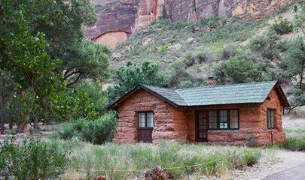
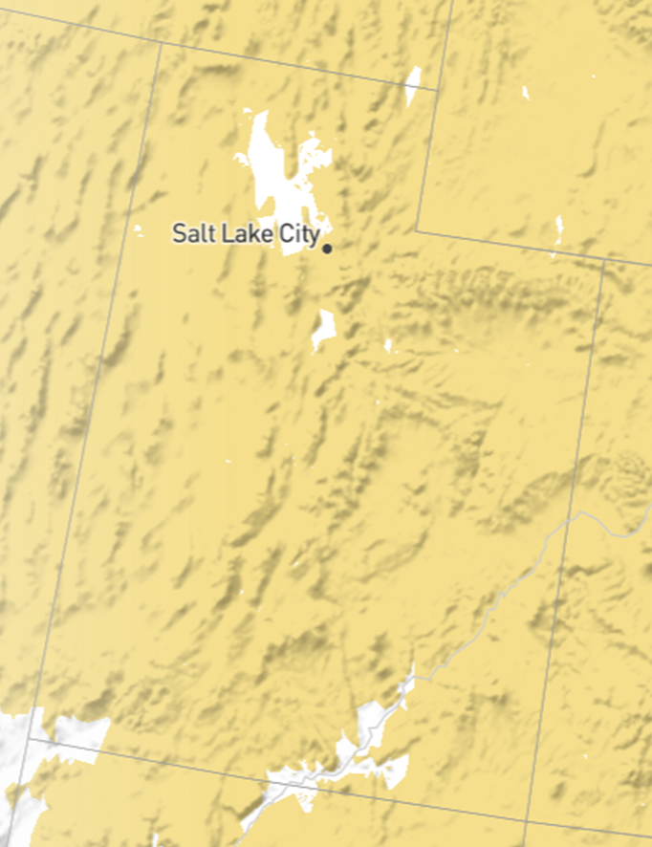
Introduction to Creating Virtual Exhibits
Lesson 4: Create a Virtual Bird Exhibit
Photo: The Zion Forever Project
Photo: NPS Zion
Image created at audobon.org

Slide 2
Virtual Exhibit Preparation & Outline
Students research and create a virtual museum exhibit about a bird that lives in their community.
The exhibit may be in the form of a slide presentation as shared on the following slides and templates. The project may also be completed as a 3D virtual space using a program such as artsteps.com.
Students should listen to the following 5 minute NPR podcast about birds and climatic change for background information useful for one section of the project.
https://www.npr.org/2014/09/09/345833757/more-than-half-of-u-s-bird-species-threatened-by-climate-change
Notes:
Students will design a virtual museum exhibit about a bird observed during their home field studies using Google Slides, Power Point, or similar presentation software. This project is designed to be a group effort where students share research and production responsibilities. Older or higher ability students could instead use a free application such as artspace.com to create 3D virtual spaces to include interior/exterior design, exhibit spaces, text panels, interactive elements, etc. The outcomes of this project are almost limitless and can provide students a chance to practice skills in Language Arts, Technology, Science, Social Studies, Design, etc. The teacher can match the specifics of the project to academic rigor and standards desired. Students should cite sources of information as directed by the teacher. In addition, students should credit photos and other images to sources. Two parts of the provided template require students are familiar with research about bird behavioral adaptations to climatic changes. The podcast story linked below covers this topic. The next slide is the beginning of the suggested exhibit template.
Student groups should choose one species from the group’s home observations to focus on for the entire exhibit.
https://www.npr.org/2014/09/09/345833757/more-than-half-of-u-s-bird-species-threatened-by-climate-change NPR podcast link

Slide 3
Northern Flicker
Click for Flicker Song
Photo by Will Elder, NPS
Notes:
Template Slide 1
Name of bird
Full body photo
Audio clip- Many free downloadable clips available at: https://www.nps.gov/subjects/sound/gallery.htm http://www.azfo.org/soundlibrary/sounds_intro.html https://www.xeno-canto.org
Students may also record audio to share.

Slide 4
Field Study Data
Field Study Data
Date(s) observed:
Time(s):
Location(s):
Number of birds observed each time:
Size of bird(s):
Color(s):
Special markings:
Behavior(s):
Description or sketch of full body:
Bill or beak sketch or description:
Feet description:
Other notes:
Notes:
Template Slide 2
Include information recorded about the bird during field observation completed during home field study. If observed on more than one occurrence or by more than one student, include all data.
Copy of the original observation sheets with sketches are desirable.

Slide 5
Overview of Northern Flicker
Name of bird: Northern Flicker
Overview: Northern Flickers are large, brown woodpeckers black-scalloped plumage with accents of red. Although you might expect to find a woodpecker in a tree, these birds are often seen on the ground foraging for food.
Habitat: Look for Northern Flickers in woodlands, forest edges, and open fields with scattered trees, as well as city parks and suburbs. You can also find them near streams and marshes.
Food: They eat mainly insects, especially ants and beetles that they gather from the ground. They also eat fruits and seeds, especially in winter.
Nesting: This bird usually excavates nest holes in dead or diseased tree trunks or large branches. They especially like aspen trees. Both sexes help with nest excavation. The entrance hole is about 3 inches in diameter, and the cavity is 13-16 inches deep. The cavity widens at bottom to make room for eggs and the incubating adult. Inside, the cavity is bare except for a bed of wood chips for the eggs and chicks to rest on.
Behavior: Northern Flickers don’t act like typical woodpeckers. They mainly forage on the ground, sometimes among sparrows and blackbirds. When flushed, flickers often perch erect on thin horizontal branches rather than hitching up or around a tree trunk. Flickers do fly Iike most woodpeckers do, rising and falling smoothly as they intersperse periods of flapping with gliding. Early in spring and summer, rivals may face off in a display sometimes called a “fencing duel,” while a prospective mate looks on. Two birds face each other on a branch, bills pointed upward, and bob their heads in time while drawing a loop or figure-eight pattern in the air, often giving rhythmic wicka calls at the same time.
Conservation: Northern Flickers are widespread and common, but numbers decreased by almost 1.5% per year between 1966 and 2012, resulting in a cumulative decline of 49%, according to the North American Breeding Bird Survey. Partners in Flight estimates a global breeding population of 9 million
Information taken directly from allaboutbirds.org, Cornell Lab of Ornithology
Notes:
Template Slide 3
All information can be found at allaboutbirds.org Make sure to credit the website and Cornell Lab of Ornithology.
Name of bird
Overview- 2-3 sentences describing the bird and its uniqueness.
Habitat
Food
Nesting
Behavior
Conservation Status

Slide 6
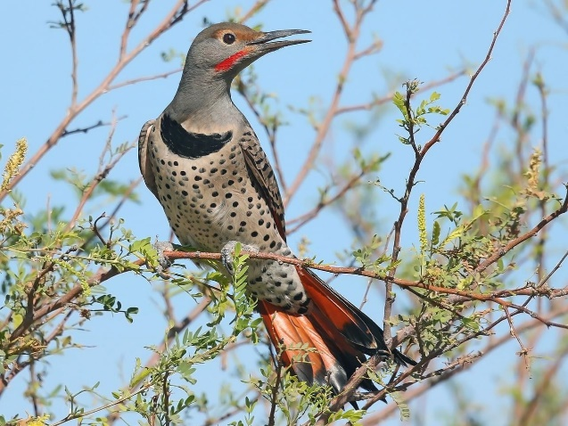
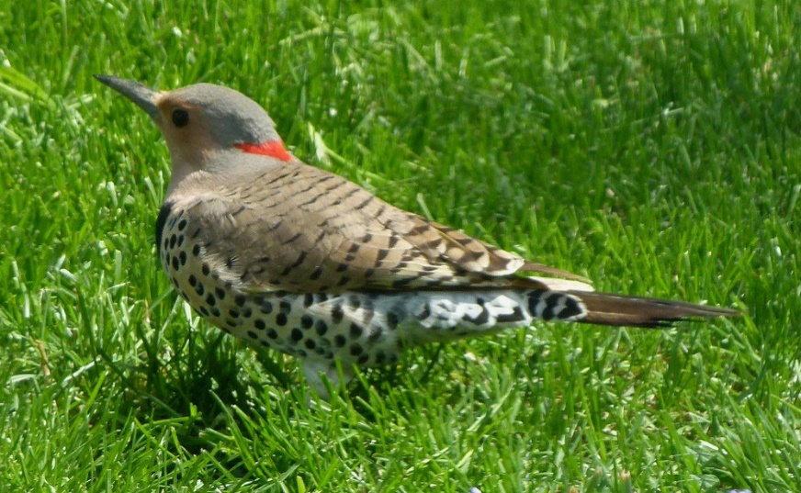
Specimen Feature Study
Long, thin bill is slightly curved and is designed for digging ants, making nest holes in trees, and drumming on trees to communicate.
Photo Matt Davis shared at Cornell Lab of Ornithology
Photo Matt Davis shared at Cornell Lab of Ornithology
The collective plumage is multi-colored mixing browns, gray, and cream allowing it to blend into the forest floor or while on a tree. There is a pattern of dark dots on the chest that is similar to that found on aspen trees. The under flight feathers are often red in western U.S. and yellow in eastern U.S.
Feet featuring thin toes with claws assist in perching on branches, grasping to side of tree trunks, and walking on the ground while searching for their favorite food, ants.
Notes:
Template Slide 4
Feature photos that highlight a closeup view of three physical features and share your inferences how the feature is an adaptation for survival. A downloaded photo can be cropped to show the feature in a closeup view as seen in this sample.
Feet, bill, and plumage are a good choice of focus.

Slide 7
Current Range in “my state”
Northern Flickers currently live in almost all of Utah. The yellow areas represent their habitat range and the white areas represent areas they do not live. The white patches are dry desert areas without trees. Northern Flickers require habitat with some forested sections with trees for nesting. They also require a place that supports their appetite for insects.
Image captured from https://www.audubon.org/field-guide/bird/northern-flicker
Notes:
Template Slide 5
Current range the bird lives within your state. Find this illustration by going here https://www.audubon.org/bird-guide and then searching the name of the bird. Next scroll down to the section “How Climate Change Will Reshape the Range of ______________”. Read through the section and carefully examine the change of range as the planet warms from climate change.
To get an image for current bird range make sure to select “Current” on the warming scenario interface. Use the pan and zoom features to capture a close view of the current range in your state. Capture this image on you computer- I used Ctrl+Print Screen. Paste the image to your slide and then crop the photo to a clean image as shown in the example.
Add some notes in the text box explaining the image, trends (why or why not you deduct the bird lives in some areas), etc.
(Instead of copying the illustration from the website, students can create their own illustration by hand or in a digital format. An example is found on Slide 9)

Slide 8
Projected Range After Climate Change in “my state”
This map shows the projected range of the Northern Flicker in Utah if the climate warms 3 degrees Celsius. The yellow represents continued habitat and the red represents lost habitat. As you can see, only about 1/3 of Utah would remain a place for Northern Flickers to live. Much of the state would become too hot and dry.
Image captured from https://www.audubon.org/field-guide/bird/northern-flicker
Notes:
Template Slide 6
Future range with 3 degrees of climate warming within your state. Follow the same steps described for the previous slide, but select “3 degrees” for the warming scenario. Find this illustration by going here https://www.audubon.org/bird-guide
Add some notes in the text box explaining the image, trends (why or why not you deduct the bird lives in some areas), etc.
The next slide features an example of a self-created image used to share range information instead of capturing an image from audobon.org.

Slide 9
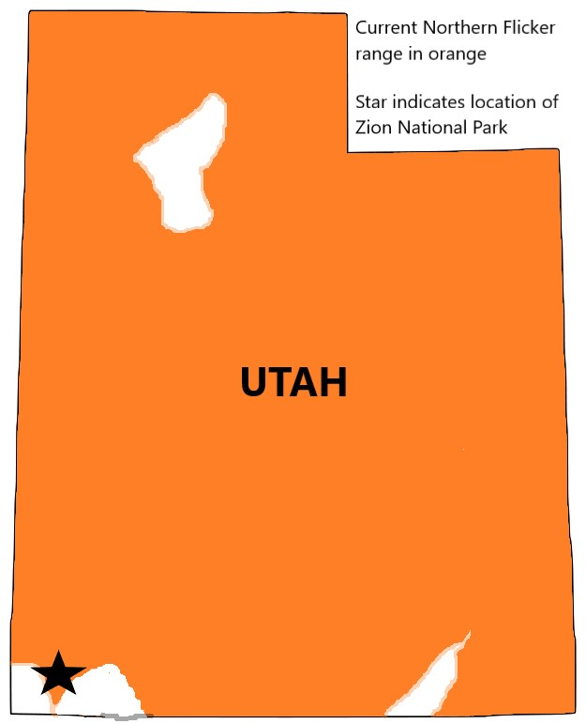
Alternate range illustration idea
Alternate range illustration created by student in Microsoft Paint or similar application. Create one for current and projected range with climate change.
Notes:
*Do not include slide in exhibit. Example of range map made in Microsoft Paint. Alternative method of creating visual for bird range.

Slide 10
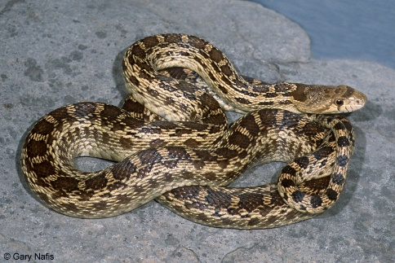
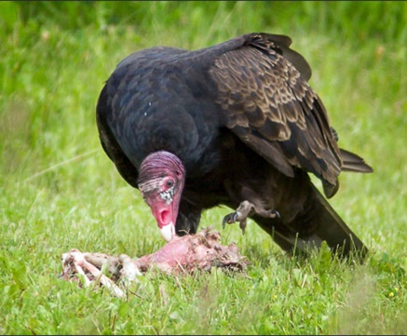
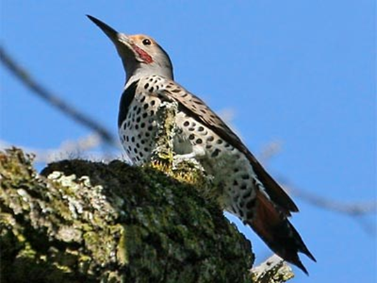
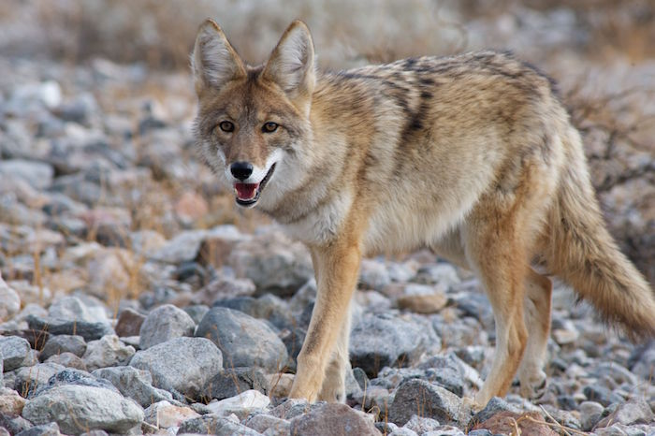
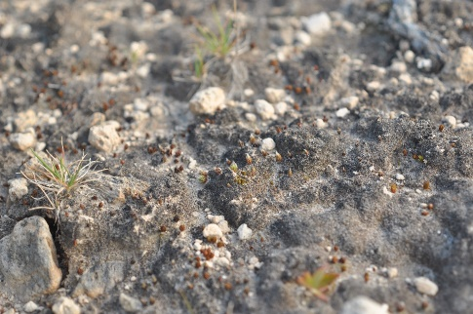
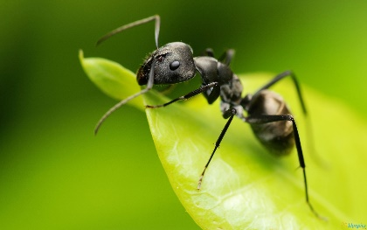
“Your Bird’s” Role in the Food Web
Gopher Snake
Turkey Vulture
Northern Flicker
Coyote
Insects
Nutrients return to soil
Biological Soil Crust- Decomposer
Photos from Creative Commons
Plants
Notes:
Template Slide 7
Create a food web model highlighting the role of producers, consumers, and decomposers while highlighting your bird. The model should represent the local ecosystem and organisms in which your bird lives. Show the flow of energy in the ecosystem.

Slide 11
Ecosystem Edits
If the Northern Flicker were pushed out of my local area because of climatic warming and arid conditions…
Write 1-2 paragraphs explaining what could happen to the local and larger ecosystem if your bird no longer could inhabit the area and the food web was disrupted.
Photo by Will Elder, NPS
Notes:
Template Slide 8
Write 1-2 paragraphs explaining what could happen to the local and larger ecosystem if your bird no longer lived there and the food web was disrupted.

Slide 12
Adapt Your Bird Project Guidelines
Listen to https://www.npr.org/2014/09/09/345833757/more-than-half-of-u-s-bird-species-threatened-by-climate-change
Sometimes in the past, animals have been able to physically adapt to naturally changing climates because the changes often occurred slowly. For example, the structure of a foot might evolve over the course of many thousands or millions of years. However, the warming temperatures we see today are happening very quickly. Species most likely cannot change body features fast enough to improve survival rates. However, scientists have documented behavioral adaptations to changing climate conditions in modern times.
For this final activity, suppose your bird is able to maintain a smaller population during a 3 degree Celsius warming trend by adopting some new behaviors. Follow the guidelines below to engineer and design an evolved version of your bird that will be able to thrive in the changed ecosystem projected for your state. Refer to the map model you made and described in Slide 7. Your teacher will decide if your modified bird model will be a computer generated model/drawing, an art sculpture, a drawing by hand, etc.
According to the changes projected, describe critical behavior changes the bird might make and how they would help them survive the changing habitat.
Design at least 3 modifications to 3 physical features of your bird. Describe and show these modifications clearly with details of how the adaptations will enhance the bird’s chances for survival over extinction.
Remove this slide from your final virtual exhibit. It is for your information only.
Notes:
*Do not include this slide in your exhibit.
Listen to the podcast linked at the beginning of the lesson or here https://www.npr.org/2014/09/09/345833757/more-than-half-of-u-s-bird-species-threatened-by-climate-change
In the past, animals have been able to physically adapt to naturally changing climates because the changes often occurred slowly. For example, the structure of a foot might evolve over the course of many thousands or millions of years. However, the warming temperatures we see today are happening very quickly. Species most likely cannot change body features fast enough to improve survival. However, scientists have documented behavioral adaptations to changing climate conditions in modern times.
For this final activity, suppose your bird is able to maintain a smaller population during a 3 degree Celsius warming trend by adopting some new behaviors. Follow the guidelines below to engineer and design an evolved version of your bird that will be able to thrive in the changed ecosystem projected for your state. Refer to the map model you made and described in Slide 8. Your teacher will decide if your modified bird model will be a computer generated model/drawing, a sculpture, a drawing by hand, etc.
According to the changes projected, describe critical behavior changes the bird might make and how they would help them survive the changing habitat.
Design at least 3 modifications to 3 physical features of your bird. Describe and show these modifications clearly with details of how the adaptations will enhance the bird’s chances for survival over extinction.
You will share these adaptations and your model in Slides 13, 14, and 15.

Slide 13
Behavioral Adaptations
Nesting- The Northern Flicker mates and nests earlier in the Spring. They also build nests in higher elevations. Both behaviors put their young in less hot environment with plenty of insects.
Diet- The Northern Flicker eats berries and fruits in greater abundance than in the past. This allows them more food choice.
Migration- The Northern Flicker migrates seasonally to follow new precipitation patterns. This behavior allows easier access to water sources and more abundant food choices.
Photo by Will Elder, NPS
Notes:
Template Slide 9
Choose 3 behaviors, modify them, and describe how this will enhance chances against extinction.

Slide 14
Physical Adaptations
Beak- The beak becomes slightly thicker and less pointed.
For diversifying its diet to include more fruit and berries. Still allows for eating insects.
Nesting in softer wooded trees does not require such a sharp beak.
Body shape and size- Overall body size is smaller.
Allows for nesting in smaller spaces.
Less energy demand in times of drought for a smaller body.
Plumage- Coloring of feathers become darker brown with muted green to match the pine trees dominating drier forest.
Camoflage from predators
Photo by Will Elder, NPS
Notes:
Template Slide 10
Choose 3 physical features, modify them, and describe how this will enhance chances against extinction.

Slide 15
Adapted Bird Model
Display an image of your newly designed bird that will meet the demands of the new ecosystem conditions it will encounter with a warming climate.
A description of how these modifications will assist the bird should be included in the slide.
Your teacher will designate if this will be a drawing, a computer-generated 3D model, sculpture, etc.
Notes:
Template Slide 11
Follow the guidelines given by your teacher. The model should showcase modified physical features that will increase your bird’s chances of survival in the case of a warming climate.
Example Changes: beak shape for new food source; color or pattern changes to feathers; feet modification; etc.

Slide 16
Works Cited
If directed by your teacher, cite your sources of information and research.
Follow formatting guidelines given by your teacher.
Notes:
Template Slide 12
Cite or give credit to your sources of information as directed by your teacher.

Slide 17
Virtual Exhibit Wrap-up
Look back over your team’s virtual exhibit and look for errors and opportunities for improvement. With your teacher’s permission you may add extra slides, links to videos, photos, articles, etc. that will enhance a person’s understanding of your bird when they “visit” your exhibit.
Speak with your teacher for further information and guidance.
Photo by Will Elder, NPS
Notes:
*Do not include this slide in your exhibit

